Slide 1

可编程逻辑器件
山西大学
白婷婷

Slide 2
第6章 常用电路的VHDL描述
本章内容：
组合电路设计
算数逻辑单元设计
时序电路设计
①计数器及其应用 ②移位寄存器及其应用
存储器设计
状态机设计

Slide 3
6.1 组合逻辑电路VHDL描述
组合电路的VHDL描述方法： 1、真值表：行为描述（IF：有优先级；CASE）
2、表达式：数据流（赋值） 3、逻辑电路：结构式（元件例化）

Slide 4
常见的组合逻辑电路：
基本门电路
编码器
译码器
数据选择器
数据比较器
8bit位的加法器
总线缓冲器
组合逻辑电路的功能可以用真值表、表达式、电路图等方式描述。基于这3种方式可以分别采用行为式、数据流式和结构式的VHDL描述风格及层次。

Slide 5
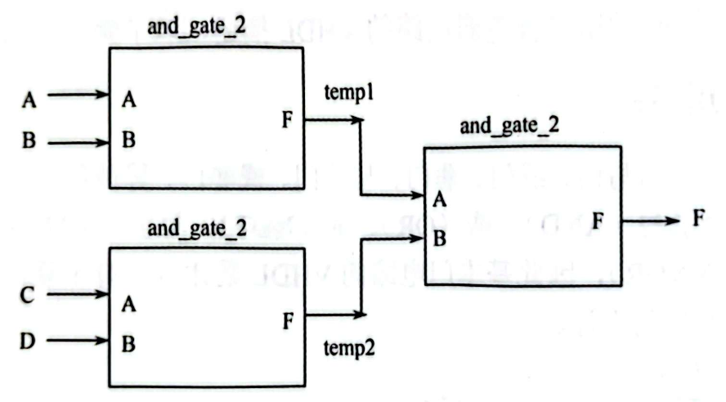
基本门电路

Slide 6
基本门电路
例6-2
Library ieee;
Use ieee.std_logic_1164.all;
Entity and_gate_4 is
Port(a, b,c,d : in std_logic;
f : out std_logic);
end and_gate_4;
architecture rtl of and_gate_4 is
begin
f<=a and b and c and d;
end rtl;
数据流描述

Slide 7
例6-3
结构化描述
下层元件描述
LIBRARY IEEE；
USE IEEE.STD_LOGIC_1164.ALL；
ENTITY AND_GATE_2 IS
PORT(A，B：IN STD_LOGIC；
C：OUT STD_LOGIC)；
END ENTITY ND2；
ARCHITECTURE DATAFLOW OF AND_GATE_2 IS
BEGIN
C<=A AND B；
END ARCHITECTURE ARTND2；

Slide 8
上层元件引用
LIBRARY IEEE；
USE IEEE.STD_LOGIC_1164.ALL；
ENTITY AND_GATE_4 IS
PORT(A，B，C，D：IN STD_LOGIC；
F：OUT STD_LOGIC)；
END ENTITY AND_GATE_4；
ARCHITECTURE STRUCTURE OF AND_GATE_4 IS
COMPONENT AND_GATE_2 IS
PORT(A，B：IN STD_LOGIC；
C：OUT STD_LOGIC)；
END COMPONENT AND_GATE_2 ；

Slide 9
上层元件引用
SIGNAL TEMP1，TEMP2：STD_LOGIC；
BEGIN
U1：AND_GATE_2 PORT MAP (A，B，TEMP1)；
U2：AND_GATE_2 PORT MAP (C，D，TEMP2)；
U3：AND_GATE_2 PORT MAP (TEMP1, TEMP2, F)；
END ARCHITECTURE STRUCTURE；

Slide 10
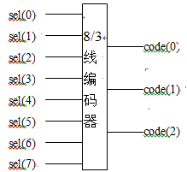
编码器
行为描述1
例 8线-3线编码器
library ieee;
use ieee.std_logic_1164.all;
entity encoder_8_3 is
port ( d : in std_logic_vector (7 downto 0);
y :out std_logic_vector (2 downto 0));
end encoder_8_3;
architecture archi of encoder_8_3 is
begin
D0
D1
D2
Y0
D3
D4
Y1
D5
D6
Y3
D7

Slide 11
process (d)
begin
if (d = “10000000”) then code <= “111”;
elsif (d = “01000000”) then code <= “110”;
elsif (d = “00100000”) then code <= “101”;
elsif (d = “00010000”) then code <= “100”;
elsif (d = “00001000”) then code <= “011”;
elsif (d = “00000100”) then code <= “010”;
elsif (d = “00000010”) then code <= “001”;
elsif (d = “00000001”) then code <= “000”;
else code<= “ZZZ”;
end if;
end process;
end archi;
D0
D1
D2
Y0
D3
D4
Y1
D5
D6
Y3
D7

Slide 12
行为描述2
例6-4 8线-3线编码器
library ieee;
use ieee.std_logic_1164.all;
entity encoder_8_3 is
port ( d : in std_logic_vector (7 downto 0);
y :out std_logic_vector (2 downto 0));
end encoder_8_3;
architecture archi of encoder_8_3 is
begin
D0
D1
D2
Y0
D3
D4
Y1
D5
D6
Y3
D7

Slide 13
process (d)
begin
case d is
when “10000000” => y<= “111”;
when “01000000” => y<= “110”;
when “00100000” => y<= “101”;
when “00010000” => y<= “100”;
when “00001000” => y<= “011”;
when “00000100” => y<= “010”;
when “00000010” => y<= “001”;
when “00000001” => y<= “000”;
when others => y<= “ZZZ”;
end case;
end process;
end archi;
D0
D1
D2
Y0
D3
D4
Y1
D5
D6
Y3
D7

Slide 14
数据流描述1
例6-5 8线-3线编码器
library ieee;
use ieee.std_logic_1164.all;
entity encoder_8_3 is
port ( d : in std_logic_vector (7 downto 0);
y :out std_logic_vector (2 downto 0));
end encoder_8_3;
architecture archi of encoder_8_3 is
begin
D0
D1
D2
Y0
D3
D4
Y1
D5
D6
Y3
D7

Slide 15
with d select
y<= “111” when “10000000” ,
“110” when “01000000” ,
“101” when “00100000” ,
“100” when “00010000” ,
“011” when “00001000” ,
“010” when “00000100” ,
“001” when “00000010” ,
“000” when “00000001” ,
“ZZZ” when others ;
end archi;
D0
D1
D2
Y0
D3
D4
Y1
D5
D6
Y3
D7

Slide 16
数据流描述2
例6-6 8线-3线编码器
library ieee;
use ieee.std_logic_1164.all;
entity encoder_8_3 is
port ( d : in std_logic_vector (7 downto 0);
y :out std_logic_vector (2 downto 0));
end encoder_8_3;
architecture archi of encoder_8_3 is
begin
D0
D1
D2
Y0
D3
D4
Y1
D5
D6
Y3
D7

Slide 17
y<= “111” when d=“10000000” else
“110” when d=“01000000” else
“101” when d=“00100000” else
“100” when d=“00010000” else
“011” when d=“00001000” else
“010” when d=“00000100” else
“001” when d=“00000010” else
“000” when d=“00000001” else
“ZZZ” ;
end archi;
D0
D1
D2
Y0
D3
D4
Y1
D5
D6
Y3
D7

Slide 18
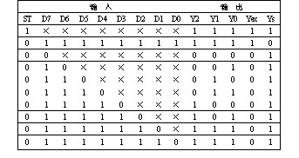
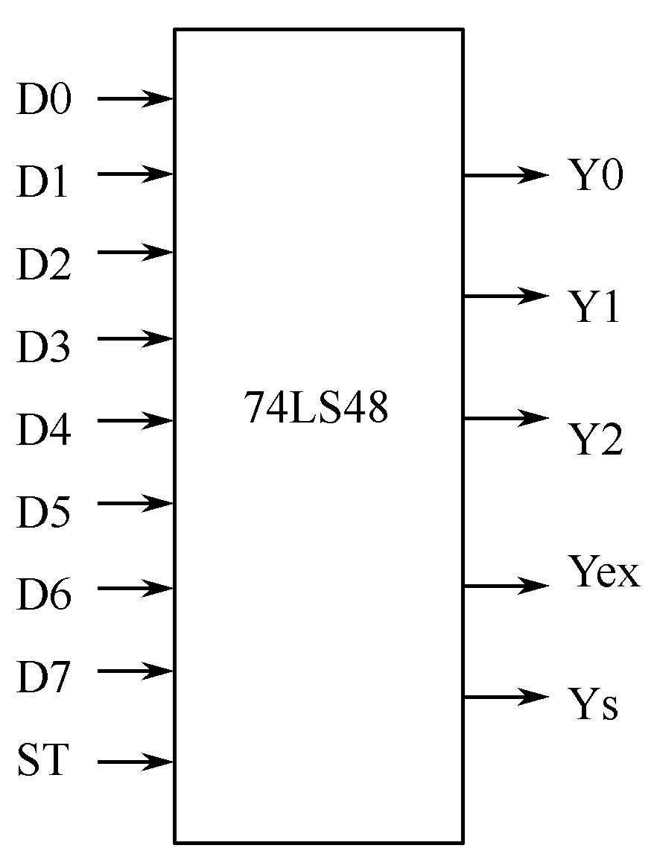
例6-7 优先编码器
真值表

Slide 19
行为描述1
library IEEE;
use IEEE.STD_LOGIC_1164.ALL;
entity encoder_74ls148 is
port ( d: in std_logic_vector(7 downto 0);
st: in std_logic;
y: out std_logic_vector(2 downto 0);
yex: out std_logic;
ys: out std_logic );
end encoder_74ls148;

Slide 20
architecture Behavioral of encoder_74ls148 is
begin
process(st,d)
begin
if st='1' then
y<="111"; yex<='1'; s <='1';
elsif d="11111111" then
y<="111"; yex<='1'; ys <='0';
elsif d(7)='0' then
y<="000"; yex<='0'; ys <='1';
… …
elsif d(0)='0' then
y<="111"; yex<='0'; ys <='1';
end if;
end process;
end Behavioral;

Slide 21
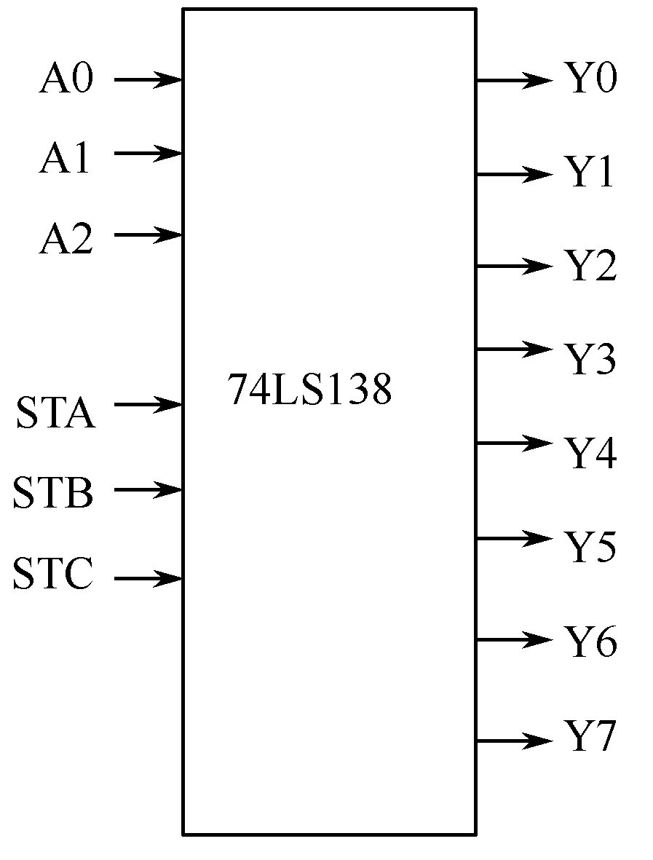
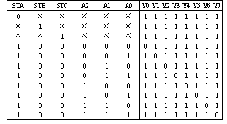
译码器
行为描述1
例6-8 3-8编码器。
真值表

Slide 22
library IEEE;
use IEEE.STD_LOGIC_1164.ALL;
entity decoder is
port (sta: in std_logic;
stb: in std_logic;
stc: in std_logic;
a: in std_logic_vector( 2 downto 0);
y: out std_logic_vector( 7 downto 0)
);
end decoder;

Slide 23
architecture Behavioral of decoder is
begin
process(sta,stb,stc,a)
begin
if (sta='1' and stb='0' and stc='0') then
case a is
when "000" => y<="11111110";
… …
when "111" => y<="01111111";
when others =>y<="11111111";
end case;
else
y<="11111111";
end if;
end process;
end Behavioral;

Slide 24

数值比较器
例6-9 两个4位二进制数比较器
行为描述1
library IEEE;
use IEEE.STD_LOGIC_1164.ALL;
entity comp is
port (a: in std_logic_vector( 3 downto 0);
b: in std_logic_vector( 3 downto 0);
a_greater_b: out std_logic;
a_less_b: out std_logic;
a_equal_b: out std_logic );
end comp;

Slide 25
architecture Behavioral1 of comp is
begin
process(a,b)
begin
if a > b then
a_greater_b<='1'; a_less_b<='0'; a_equal_b<='0';
elsif a < b then
a_greater_b<='0'; a_less_b<='1'; a_equal_b<='0';
else
a_greater_b<='0'; a_less_b<='0'; a_equal_b<='1';
end if;
end process;
end Behavioral1;

Slide 26
例6-9 两个4位二进制数比较器
数据流描述1
library IEEE;
use IEEE.STD_LOGIC_1164.ALL;
entity comp is
port (a: in std_logic_vector( 3 downto 0);
b: in std_logic_vector( 3 downto 0);
a_greater_b: out std_logic;
a_less_b: out std_logic;
a_equal_b: out std_logic );
end comp;

Slide 27
architecture Behavioral2 of comp is
begin
a_greater_b<='1' when a>b else ‘0’;
a_less_b<='1' when a<b else ‘0’;
a_equal_b<='1' when a=b else ‘0’;
end Behavioral2;

Slide 28
数据比较器
例6-10 8选1的数据比较器
Library ieee;
use ieee.std_logic_1164.all;
entity multiplexers is
port ( d : in std_logic_vector (7 downto 0);
sel : in std_logic_vector (2 downto 0);
y : out std_logic);
end multiplexers;

Slide 29
architecture archi_1 of multiplexers is
begin
process (d, sel)
begin
if (sel = "000") then y <= d(0);
elsif (sel = "001") then y <= d(1);
......
elsif (sel = "111") then y <= d(7);
else y <= 'Z';
end if;
end process;
end archi_1;
行为描述1

Slide 30
architecture archi_2 of multiplexers is
begin
process ( d, sel)
begin
case sel is
when "000" => y <= d(0);
when "001" => y <= d(1);
......
when "111" => y<= d(7);
when others => y <= 'Z';
end case;
end process;
end archi_2;
行为描述2

Slide 31
architecture archi_3 of multiplexers is
begin
y<= d(0) when sel = “000” else
d(1) when sel = “001” else
......
d(7) when sel = “111” else
'Z' ;
end archi_3;
数据流描述1

Slide 32
architecture archi_4 of multiplexers is
begin
with sel select
q<=d(0) when “000” ,
d(1) when “001” ,
.......
d(7) when “111” ,
‘Z' when others；
end archi_4;
数据流描述2

Slide 33
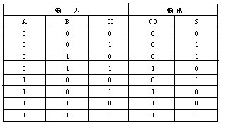
1位全加器
数据流式： 1位全加器
表达式
真值表

Slide 34
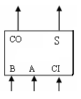
程序设计—实体
library ieee;
use ieee.std_logic_1164.all;
entity adder1 is
port (a,b,ci: in std_logic;
co,s: out std_logic);
end adder1;

Slide 35
程序设计—结构体
architecture behavioral of adder1 IS
begin
co<=(a and b) or (a and ci) or (b and ci);
s<=a xor b xor ci;
end behavioral;

Slide 36
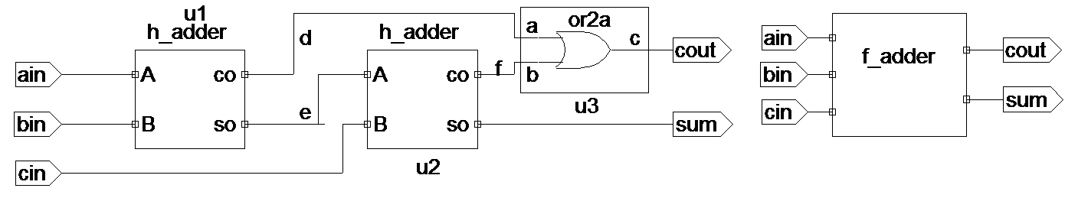

结构式： 1位全加器

Slide 37
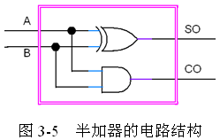
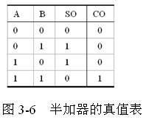
下层元件描述

Slide 39
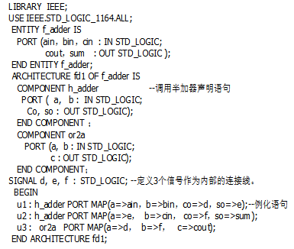
上层元件引用

Slide 40
三态门电路
library IEEE;
use IEEE.STD_LOGIC_1164.ALL;
entity tri_gate is
port (a: in std_logic;
b: in std_logic;
en: in std_logic;
f: out std_logic );
end tri_gate;

Slide 41
architecture Behavioral of tri_gate is
begin
process(a,b,en)
begin
if en='1' then
f<=a nand b;
else
f<='Z';
end if;
end process;
end Behavioral;

Slide 42
双向端口设计
结构图：
双进程描述：【例】6-14
DIR
A
B
LIBRARY IEEE;
USE IEEE.STD_LOGIC_1164.ALL;
ENTITY BIDIR IS
PORT(A,B：INOUT STD_LOGIC_VECTOR(7 DOWNTO 0);
DIR：IN STD_LOGIC);
END ENTITY BIDIR;

Slide 43
ARCHITECTURE ART OF BIDIR IS
SIGNAL AOUT,BOUT：STD_LOGIC_VECTOR(7 DOWNTO 0);
BEGIN
PROCESS(A,DIR) IS --A为输入
BEGIN
IF (DIR=‘1’) THEN
BOUT<=A;
ELSE
BOUT<="ZZZZZZZZ"；
END IF;
B<=BOUT; --B为输出
END PROCESS;
进程A设计：
DIR
A
B

Slide 44
进程B设计：
PROCESS(B,DIR) IS --B为输入
BEGIN
IF(DIR=‘0’)THEN
AOUT<=B;
ELSE
AOUT<="ZZZZZZZZ";
END IF;
A<=AOUT; --A为输出
END PROCESS;
END ARCHITECTURE ART;
DIR
A
B

Slide 45
单进程描述：【例】6-15
ARCHITECTURE ART OF BIDIR IS
BEGIN
Process (A,B,DIR)
begin
if (DIR='0') then
A<= B;
B<= "ZZZZZZZZ";
Else
B <=A;
A <="ZZZZZZZZ";
end if;
end process;
END ARCHITECTURE ART;
DIR
A
B

Slide 46
6.2 数据运算的VHDL描述
数据运算操作主要包含加法操作、减法操作、乘法操作和除法操作，由这四种运算单元和逻辑运算单元一起，可以完成复杂数学运算。
HDL语言中提供了丰富的数据算术操作的运算符。

Slide 47
加法运算
（1）一位全加器设计
（2）4位二进制加法器设计
数据流式： 1位全加器
表达式
真值表

Slide 48
程序设计—实体
library ieee;
use ieee.std_logic_1164.all;
entity adder1 is
port (a,b,ci: in std_logic;
co,s: out std_logic);
end adder1;

Slide 49

程序设计—结构体
architecture behavioral of adder1 IS
begin
co<=(a and b) or (a and ci) or (b and ci);
s<=a xor b xor ci;
end behavioral;

Slide 50
（2）4位二进制加法器设计
architecture behavioral of adder4 IS
signal c: std_logic_vector(2 downto 0); --内部进位信号
component adder1 is
port (a,b,ci: in std_logic;
co,s: out std_logic
);
end component;
begin
U0: adder1 port map(a=>a(0),b=>b(0),ci=>cin,co=>c(0),s=>s(0));
U1: adder1 port map(a=>a(1),b=>b(1),ci=>c(0),co=>c(1),s=>s(1));
U2: adder1 port map(a=>a(2),b=>b(2),ci=>c(1),co=>c(2),s=>s(2));
U3: adder1 port map(a=>a(3),b=>b(3),ci=>c(2),co=>cout,s=>s(3));
end behavioral;

Slide 51
加法运算
带进位输入和输出无符号8比特加法器VHDL描述
library ieee;
use ieee.std_logic_1164.all;
entity adders_4 is
port(A,B,CI : in std_logic_vector(7 downto 0);
SUM : out std_logic_vector(7 downto 0);
CO : out std_logic);
end adders_4;

Slide 52
architecture archi of adders_4 is
signal tmp: std_logic_vector(8 downto 0);
begin
SUM <= tmp(7 downto 0);
CO <= tmp(8);
tmp <= conv_std_logic_vector((conv_integer(A) + conv_integer(B)
+conv_integer(CI)),9);
end archi;

Slide 53
加法运算
带进位输入和输出无符号8比特加法器VHDL描述
library ieee;
use ieee.std_logic_1164.all;
use ieee.std_logic_arith.all;
use ieee.std_logic_unsigned.all;
entity adders_4 is
port(A,B,CI : in std_logic_vector(7 downto 0);
SUM : out std_logic_vector(7 downto 0);
CO : out std_logic);
end adders_4;

Slide 54
architecture archi of adders_4 is
signal A1,B1,tmp: std_logic_vector(8 downto 0);
begin
A1<=‘0’&A;
B1<=‘0’&B;
tmp <= A1 + B1 +CI;
SUM <= tmp(7 downto 0);
CO <= tmp(8);
end archi;

Slide 55
减法运算
无符号8位带借位减法器的VHDL描述
library IEEE;
use IEEE.STD_LOGIC_1164.ALL;
use IEEE.STD_LOGIC_UNSIGNED.ALL;
entity adders_8 is
port(A,B : in std_logic_vector(7 downto 0);
BI : in std_logic;
RES : out std_logic_vector(7 downto 0));
end adders_8;
architecture archi of adders_8 is
begin
RES <= A - B - BI;
end archi;

Slide 56
乘法运算
8位和4位无符号的乘法操作的VHDL描述
library ieee;
use ieee.std_logic_1164.all;
use ieee.std_logic_unsigned.all;
entity multipliers_1 is
port(A : in std_logic_vector(7 downto 0);
B : in std_logic_vector(3 downto 0);
RES : out std_logic_vector(11 downto 0));
end multipliers_1;
architecture beh of multipliers_1 is
begin
RES <= A * B;
end beh;

Slide 57
除法运算
无符号8位被除数和8位除数除法操作VHDL描述
library IEEE;
use IEEE.STD_LOGIC_1164.ALL;
use IEEE.STD_LOGIC_ARITH.ALL;
use IEEE.STD_LOGIC_UNSIGNED.ALL;
entity div is
Port ( numerator : in std_logic_vector(7 downto 0);
denominator : in std_logic_vector(7 downto 0);
quotient : out std_logic_vector(7 downto 0);
remainder : out std_logic_vector(7 downto 0)
);
end div;

Slide 58
architecture Behavioral of div is
begin
process(numerator,denominator)
begin
if(denominator/="00000000") then
quotient<=conv_std_logic_vector(conv_integer(numerator)/conv_integer(denominator),8);

Slide 59
remainder<=conv_std_logic_vector(conv_integer(numerator)rem conv_integer(denominator),8);
else
quotient<="00000000";
remainder<="00000000";
end if;
end process;
end Behavioral;

Slide 60
算数逻辑单元
前面介绍了加法器和减法器电路的设计。通过增加一些逻辑操作，设计一个叫做算术/逻辑单元ALU的模块。
由于ALU包含了所希望实现的功能集的电路，因此很容易替换/扩展来包含不同的操作。

Slide 61
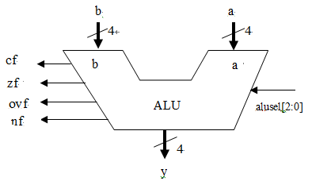
ALU操作
alusel[2:0] | 功能 | 输出
000 | 传递a | a
001 | 加 | a+b
010 | 减1 | a-b
011 | 减2 | b-a
100 | 取反 | not a
101 | 与 | a and b
110 | 或 | a or b
111 | 异或 | a xor b

Slide 62
由于ALU完成8种功能，所以选择线为3位.
此外，ALU提供4位的y输出和四个标志位。其中：
cf为进位标志；
ovf为溢出标志；
zf为0标志（当输出为0时，该标志有效）；

Slide 63
为了讨论进位标志和溢出标志的不同，考虑一个8位的加法（最高位为符号位）。当无符号的数的和超过255时，进位标志被设置。当有符号数的和超过了-128-+127的范围时，溢出标志被设置。

Slide 64
考虑下面的几个例子(最高位为符号位)：
53₁₀+25₁₀=35₁₆+19₁₆=78₁₀=4E₁₆,cf=0,ovf=0
53₁₀+91₁₀=35₁₆+5B₁₆=144₁₀=90₁₆,cf=0,ovf=1
53₁₀-45₁₀=35₁₆+D3₁₆=8₁₀=08₁₆, cf=1,ovf=0
-98₁₀-45₁₀=9E₁₆+D3₁₆=-143₁₀=171₁₆,cf=1,ovf=1
当满足条件：（第七位向第八位进位） xor （第八位向cf进位）时，ovf=1。

Slide 65
算术逻辑单元ALU的VHDL描述
library IEEE;
use IEEE.STD_LOGIC_1164.ALL;
use IEEE.STD_LOGIC_ARITH.ALL;
use IEEE.STD_LOGIC_UNSIGNED.ALL;
entity alu4 is
port(
a : in std_logic_vector(3 downto 0);
b : in std_logic_vector(3 downto 0);
alusel : in std_logic_vector(2 downto 0);
y : out std_logic_vector(3 downto 0);

Slide 66
nf : out std_logic;
zf : out std_logic;
cf : out std_logic;
ovf : out std_logic
);
end alu4;
architecture Behavioral of alu4 is
begin
process(a,b,alusel)
variable temp : std_logic_vector(4 downto 0):="00000";
variable y_temp : std_logic_vector(3 downto 0):="0000";
begin

Slide 67
cf<='0';
ovf<='0';
case alusel is
when "000"=> y_temp:=a;
when "001"=>
temp:=('0'&a)+('0'&b);
y_temp:=temp(3 downto 0);
cf<=temp(4);
ovf<=temp(3) xor a(3) xor b(3) xor temp(4);

Slide 68
when "010"=>
temp:=('0'&a)-('0'&b);
y_temp:=temp(3 downto 0);
cf<=temp(4);
ovf<=temp(3) xor a(3) xor b(3) xor temp(4);
when "011"=>
temp:=('0'&b)-('0'&a);
y_temp:=temp(3 downto 0);
cf<=temp(4);
ovf<=temp(3) xor a(3) xor b(3) xor temp(4);
when "100"=>
y_temp:=not a;
when "101"=>
y_temp:=a and b;

Slide 69
when "110"=>
y_temp:=a or b;
when "111"=>
y_temp:=a xor b;
when others=>
y_temp:=a;
end case;
nf<=y_temp(3);
y<=y_temp;

Slide 70
if(temp="0000") then
zf<='1';
else
zf<='0';
end if;
end process;
end Behavioral;

